Slide 1

DataSpread: Unifying Databases and Spreadsheets
Mangesh Bendre

Slide 2
Data Analytics to the People
Most of the people doing ad-hoc data manipulation and analysis use spreadsheets,
e.g., Excel
Why?
Easy to use: direct manipulation of data
Built-in visualization capabilities
Flexible: no need for a schema

Slide 3
But Spreadsheets are Terrible!
Slow
single change ➔ wait minutes on a 10,000 x 10 spreadsheet
can’t even open a spreadsheet with >1M cells
speed by itself can prevent analysis
Tedious + not Powerful
filters via copy-paste
only FK joins via VLOOKUPs; others impossible
even simple operations are cumbersome
Brittle
sharing excel sheets around, no collab/recovery
using spreadsheets for collaboration is painful and error-prone

Slide 4
Let’s turn to Databases
Databases are:
Slow Scalable
Tedious + not Powerful Powerful and expressive (SQL)
Brittle Collaboration, recovery, succinct
So why not use databases?
Well, for the same reason why spreadsheets are so useful:
Easy to use Not easy to use
Built-in visualization No built-in visualization
Flexible Not flexible

Slide 5
Combining the benefits of spreadsheets and databases
Spreadsheet as a frontend interface
Databases as a backend engine
Result: retain the benefits of both!
But it’s not that simple…

Slide 6
Different Ideologies
Databases and spreadsheets have different ideologies that need to be reconciled…
Due to this, the integration is not trivial…
Feature | Databases | Spreadsheets
Data Model | Schema-first | Dynamic/No Schema
Addressing | Tuples with PK | Cells, using Row/Col
Presentation | Set-oriented, no such notion | Notion of current window, order
Modifications | Must correspond to queries | Can be done at any granularity
Computation | Query at a time | Value at a time

Slide 7
High Level Idea
Key Thrusts
Scalability
Millions to billions of rows
Expressiveness
Express complex operations easily
Capabilities
Collaboration, versioning

Slide 8
Current Progress
Version 0.1:
Integration of spreadsheets and databases.
Scalable spreadsheets.
Version 0.3:
Support for tables on a spreadsheet
Relational Operators.
SQL
Asynchronous formula computation.
Multi-cell functions.
Capture dependency using database.

Slide 9
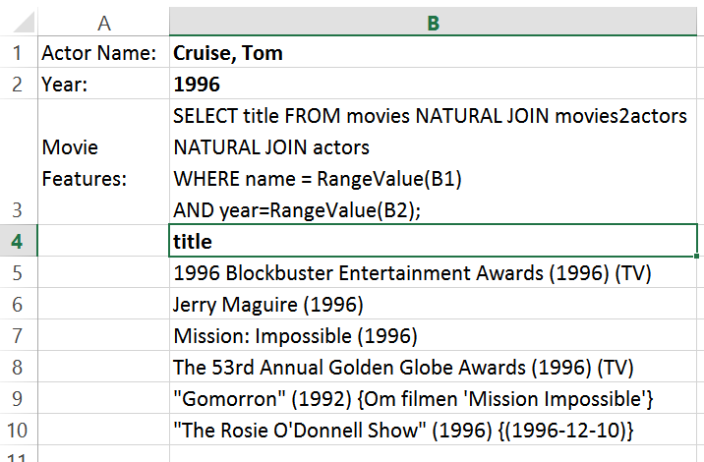
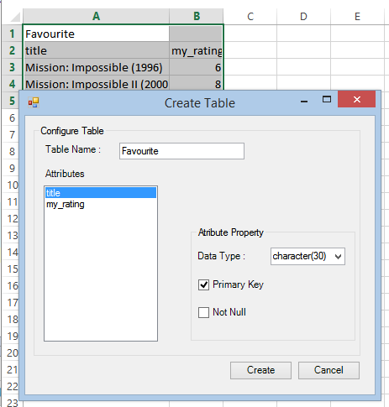
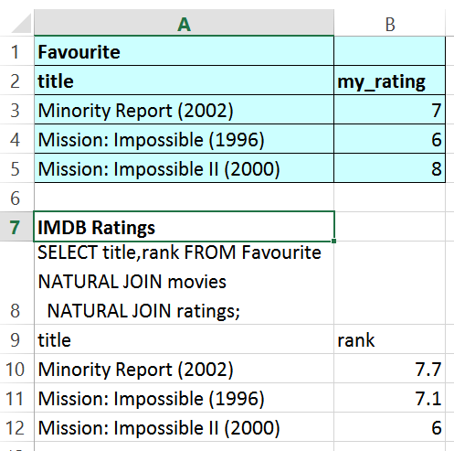
Initial Prototype: Excel Based

Slide 10
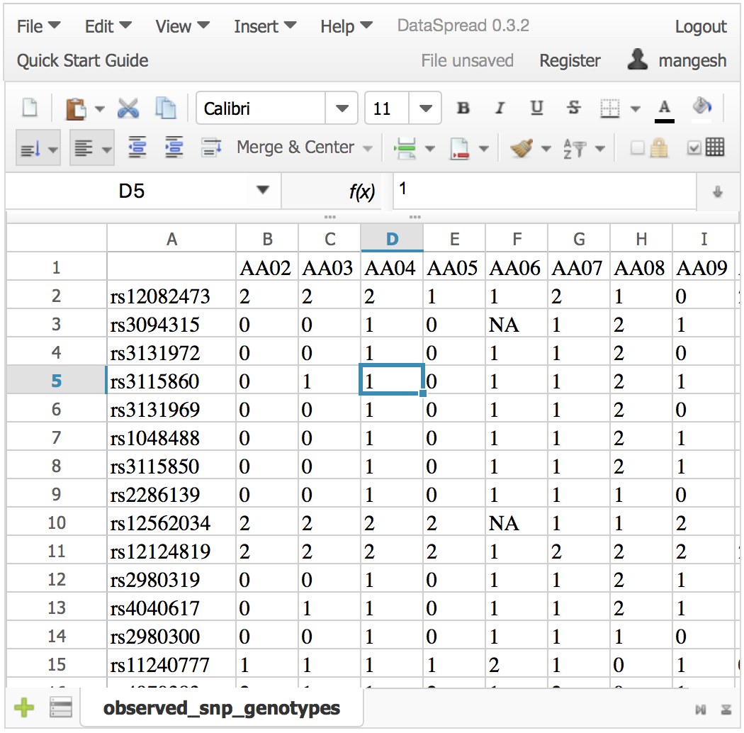
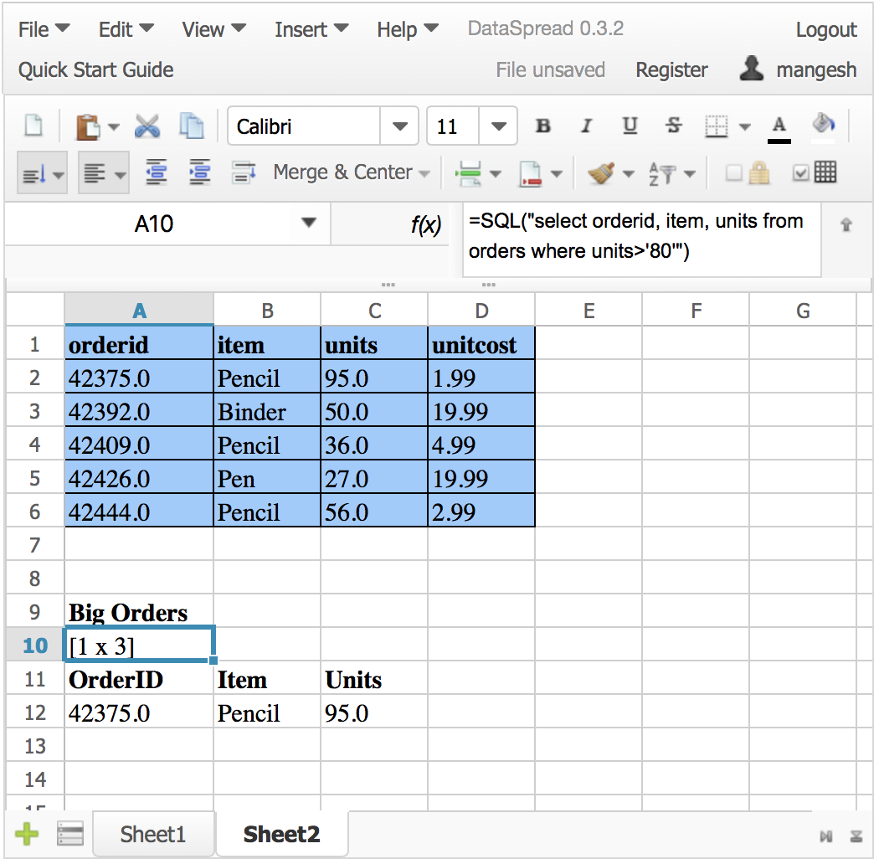
Current Prototype: Web Based

Slide 11
Scalability
Goal : To effortlessly handle spreadsheets with billions of cells.
Problem: How do we represent the data to allow efficient access ?

Slide 12
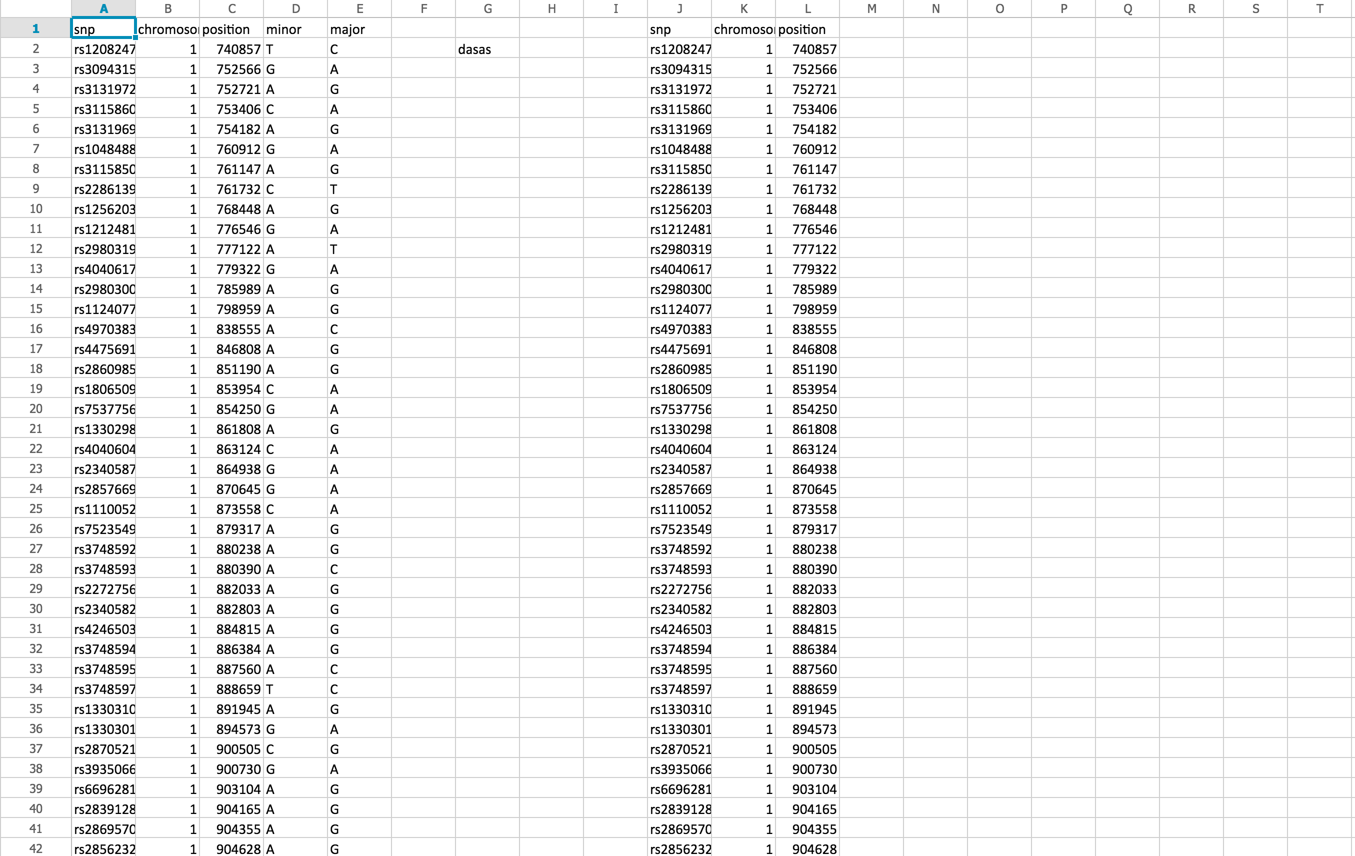
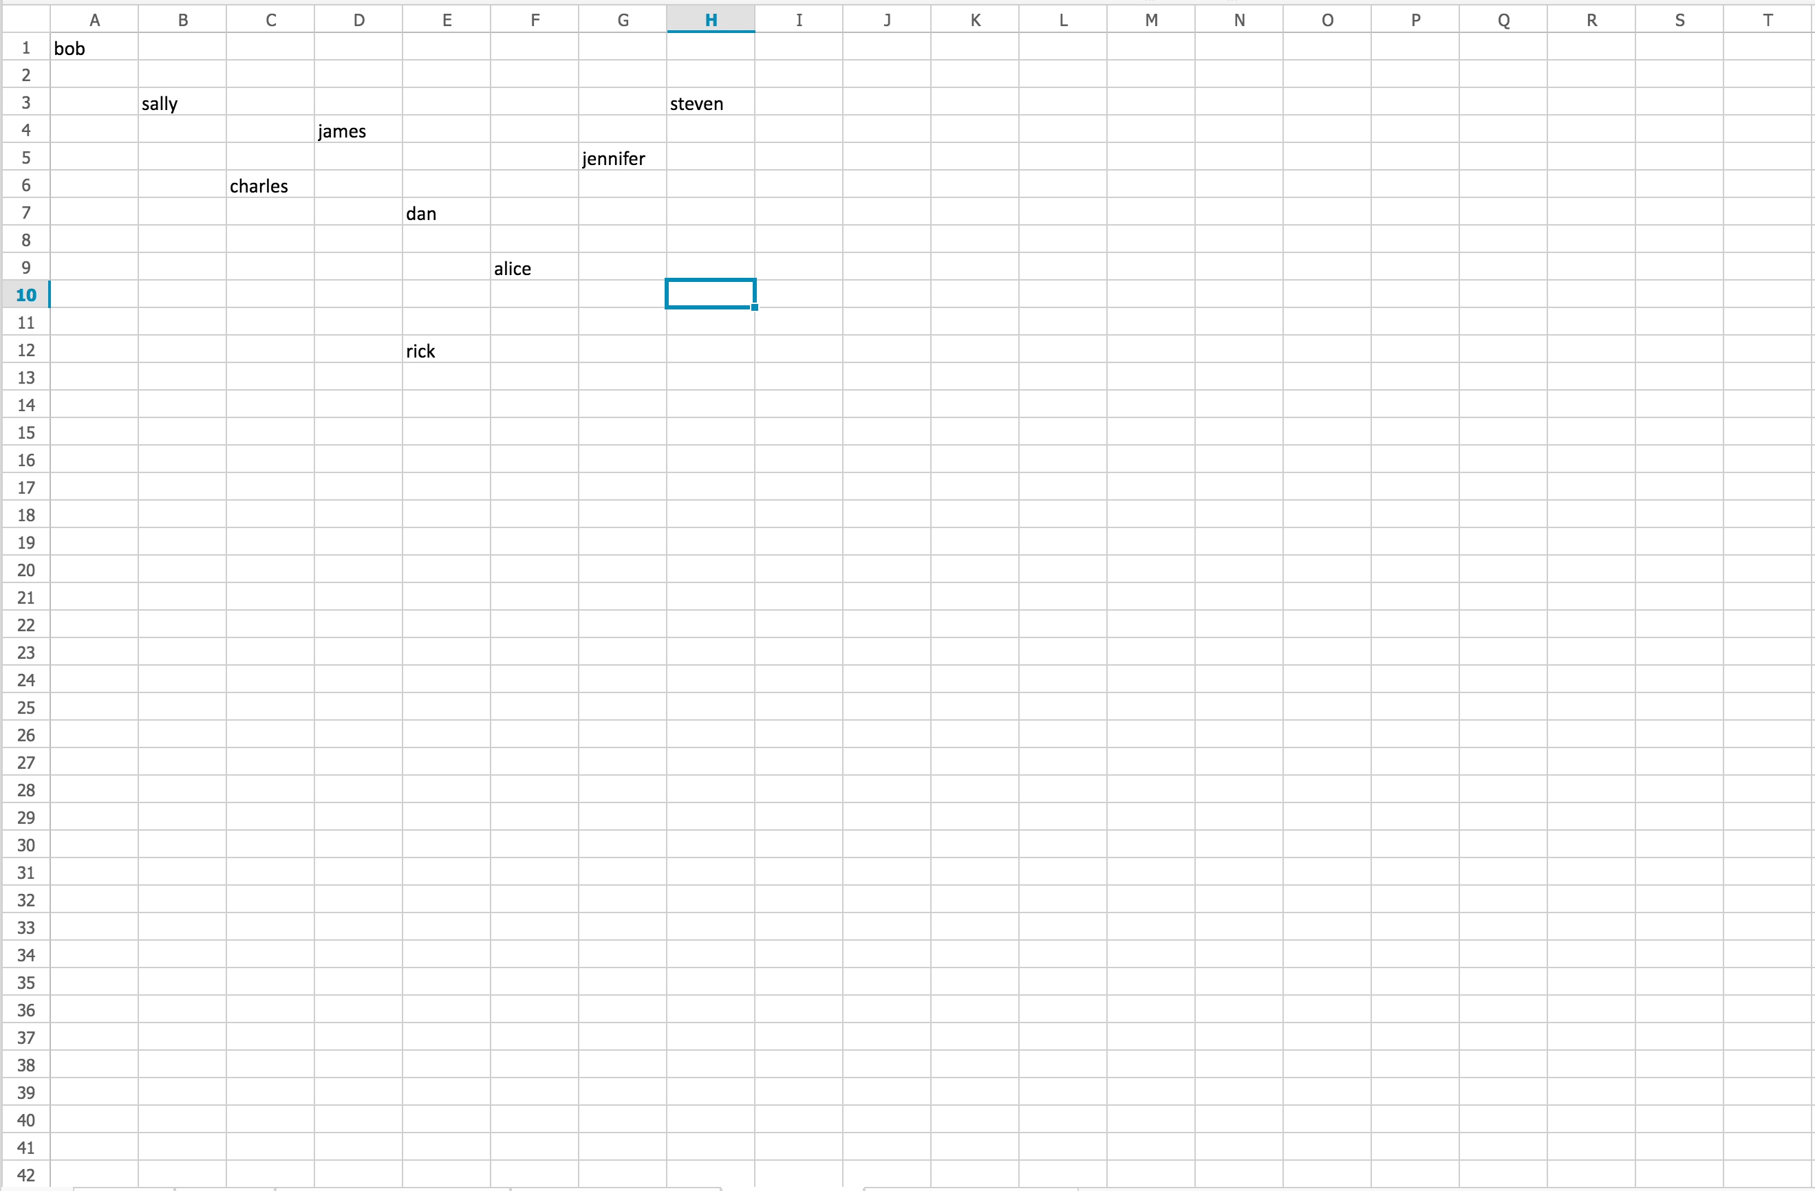
Problem: Representation
Q: how do we represent spreadsheet data?
Dense spreadsheets: represent as tables
(Row #, Col1 val, Col2 val, …)
Sparse spreadsheets: represent as triples
(Row #, Column #, Value)

Slide 13
Problem: Representation
However, even if we only use “tables”, carving out the ideal # partitions (min. storage, modif., access)
is NP-Hard
Reduction from min. edge-length partition of rectilinear polygons
Thankfully, we have a way out…

Slide 14
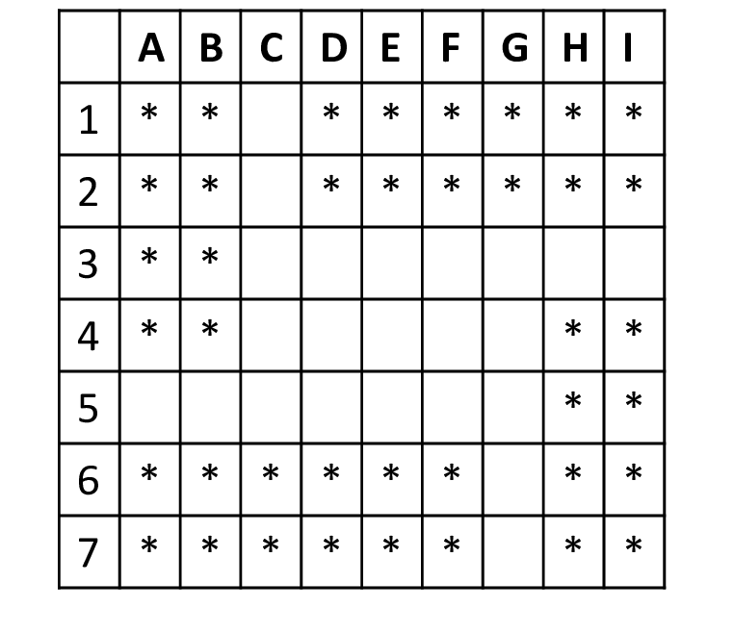
Solution: Constrain the Problem
A new class of partitionings: recursive decomp.
A very natural class of partitionings!

Slide 15
Solution: Constrain the Problem
The optimal recursive decomp. partitioning can be found in PTIME using DP
➔ Still quadratic in # rows, columns ☹
Merge rows/columns with identical signatures
~ the time for a single scan

Slide 16
Problem: Spreadsheet operations
Q: how do we support spreadsheet operations like insert/delete row/column?
Inserting a row requires updating the row numbers of subsequent rows.

Slide 17
Solution : Positional Indexing
A: Indexing structure that enables efficient spreadsheet operations.
Insert, Delete and Lookup in
O(log N)

Slide 18
Framework

Slide 19
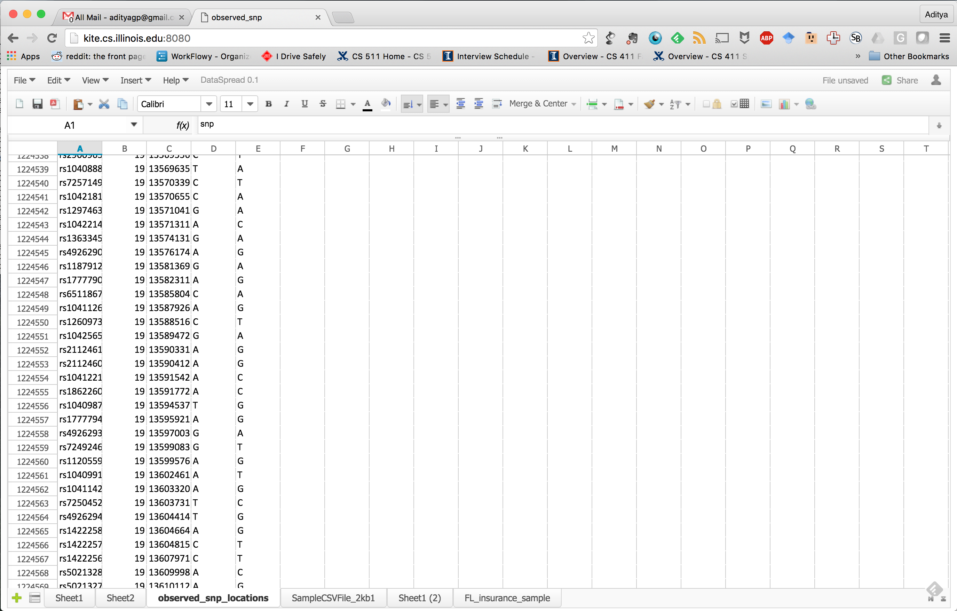
Current Prototype
PostgreSQL backend
ZK spreadsheet
open-source web frontend
Comfortably scales to arbitrarily many rows
+ additional features.
Hopefully bring spreadsheets to the big data age!
1224560

Slide 20
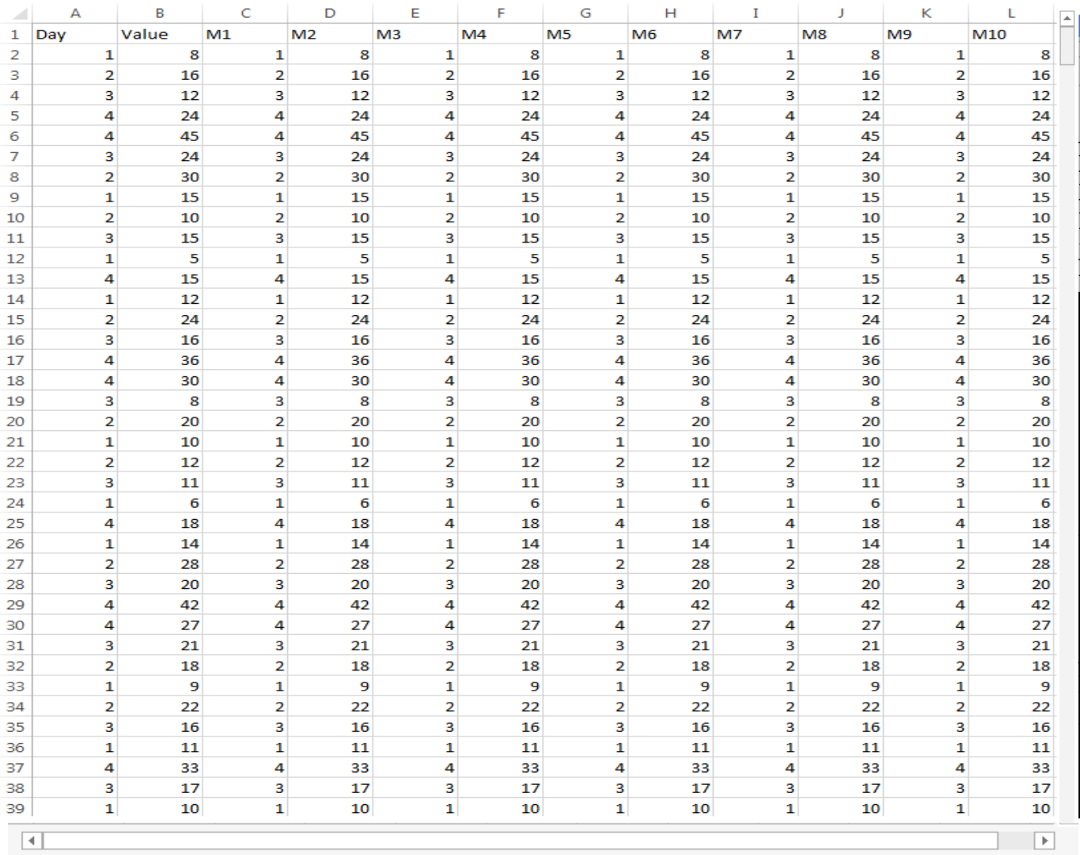
Problem: Navigation
How to browse big data ?

Slide 21
Solution: Navigation Support

Slide 22
Scalability
Goal : To effortlessly handle spreadsheets with billions of cells and formulae.
Problem: How do we maintain interactivity while dealing with large and complex formulae?

Slide 23
Interactivity for Formula Computation
Observation: A formula that accesses a million cell cannot be executed interactively (<500ms).
Solution: Asynchronous formula computation.
Challenges: How to present a consistent view of the spreadsheet?

Slide 24
Asynchronous formula Computation
Consistent view:-
Never show incorrect data to users.
Identify dependent cells in a constant time.
Tolerate False positives.
Dependency Graph Compression.
Computation Scheduling
I/O is a bottleneck. How to fetch cells for efficient computation ?

Slide 25
Expressivity
Goal : To make spreadsheets more expressive.
Inspired from relational databases.
Support the notion of tables on spreadsheets
Relational algebra.
SQL.

Slide 26
Table Management
Tables synced with the backend in real-time.
Create table
Link
Unlink
Add tuples
Delete tuples
Add Rows
Delete Rows.

Slide 27
Relational Operators.
UNION
DIFFERENCE
INTERSECTION
CROSSPRODUCT
SELECT
PROJECT
RENAME
JOIN
Input is a table
Output is a table cell.

Slide 28
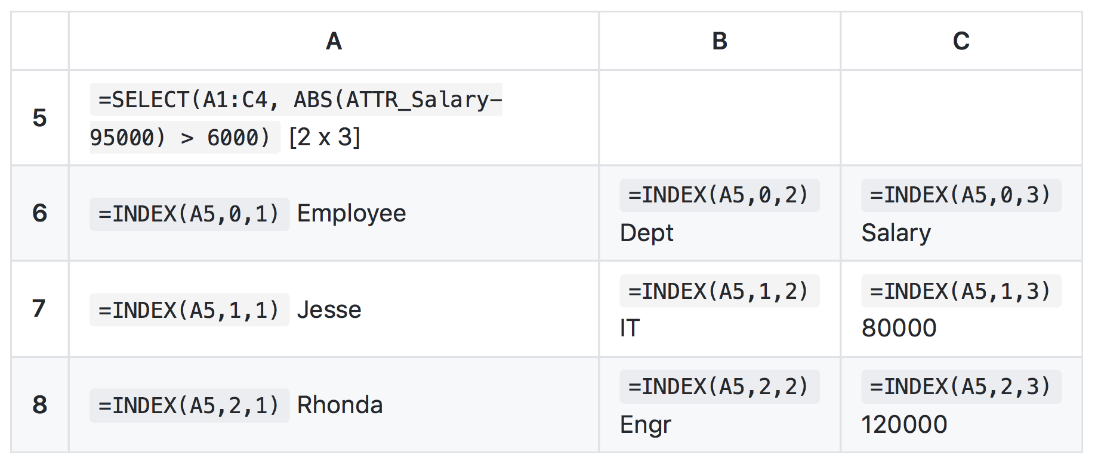
Multi Cell Functions.

Slide 29
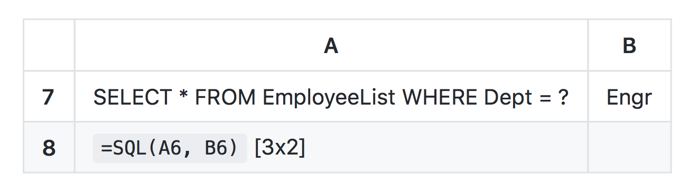
Support for SQL.
Leverage backend Database
Input is a SQL
Output is a table cell.

Slide 30
Demo!
http://dataspread.github.io

Slide 31


